Slide 1
Chapter 2: Basic Image Representation
AMSE - Course on Computer Vision - 2024

Slide 2
Overview of Chapter 2
Understanding digital images
Image formation
Pixels
Color spaces (RGB, Grayscale)
Image format
Loading and displaying images using Python and OpenCV
Image manipulation
Resizing
Cropping
Flipping
Rotating

Slide 3
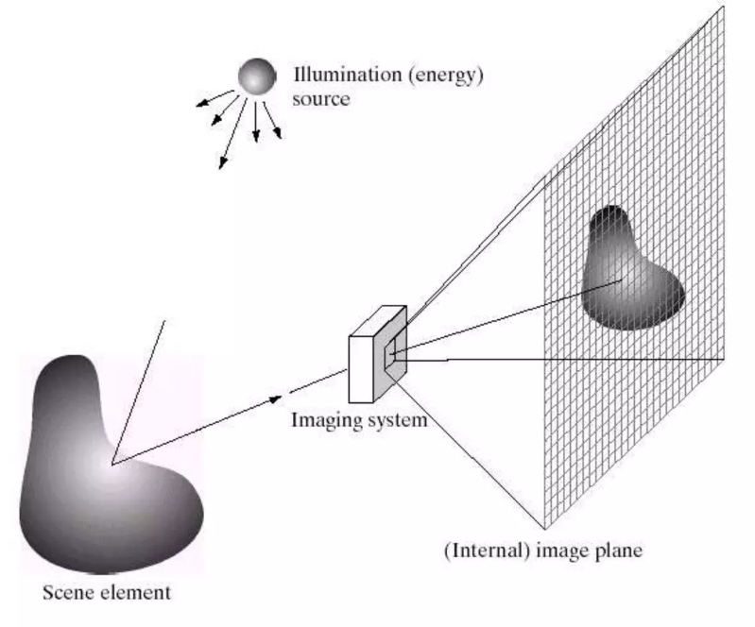
Understanding digital images
Image Formation

Slide 4
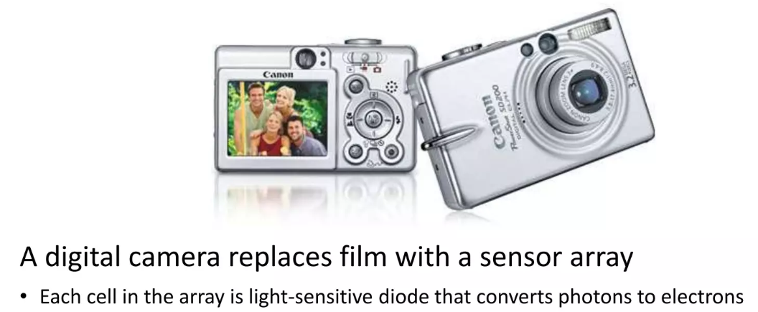
Understanding digital images
Digital Camera

Slide 5
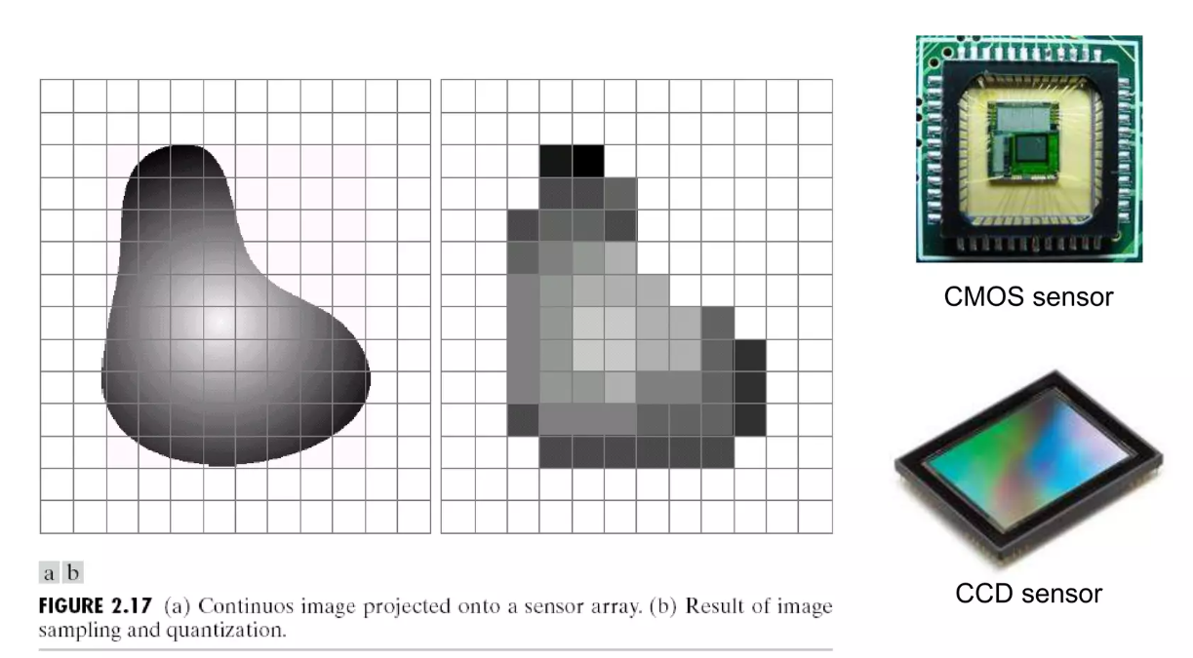
Understanding digital images
Sensor Array

Slide 6
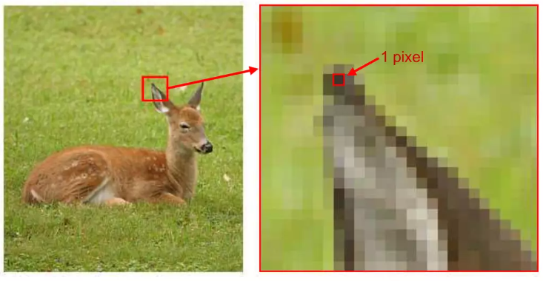
Understanding digital images
Pixel

Slide 7
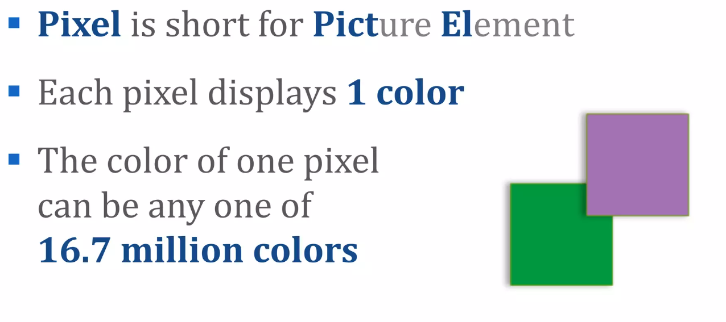
Understanding digital images
Pixel

Slide 8
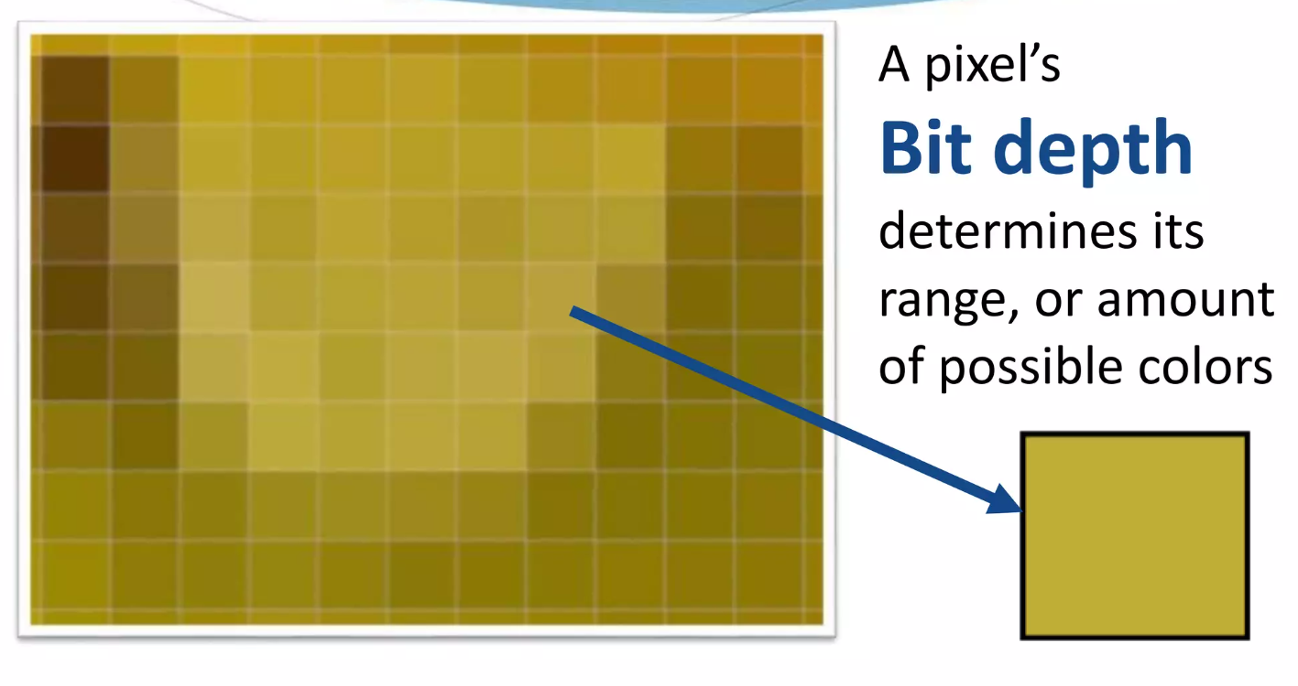
Understanding digital images
Pixel

Slide 9
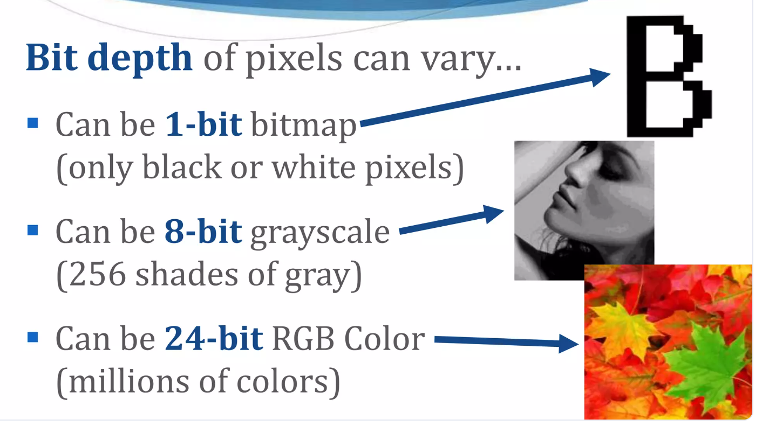
Understanding digital images
Pixel

Slide 10
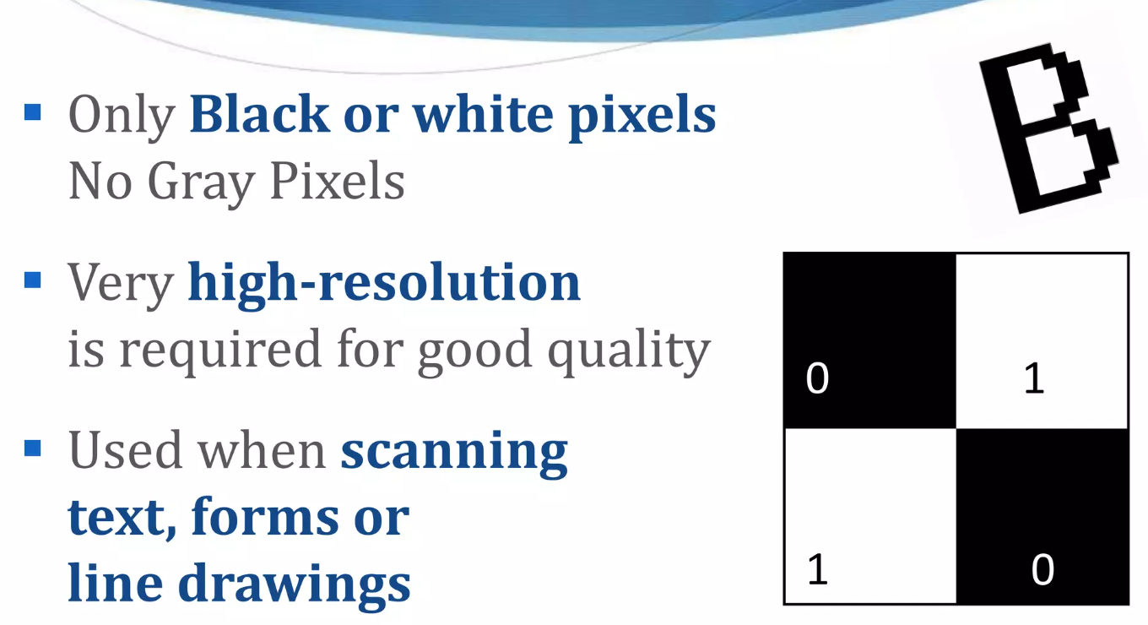
Understanding digital images
Pixel : 1 bit – Bitmap (Binary)

Slide 11
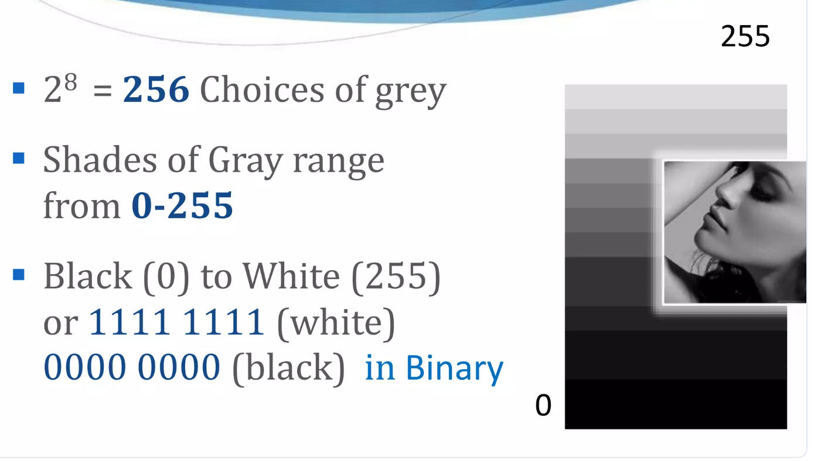
Understanding digital images
Pixel : 8 bit - Grayscale

Slide 12
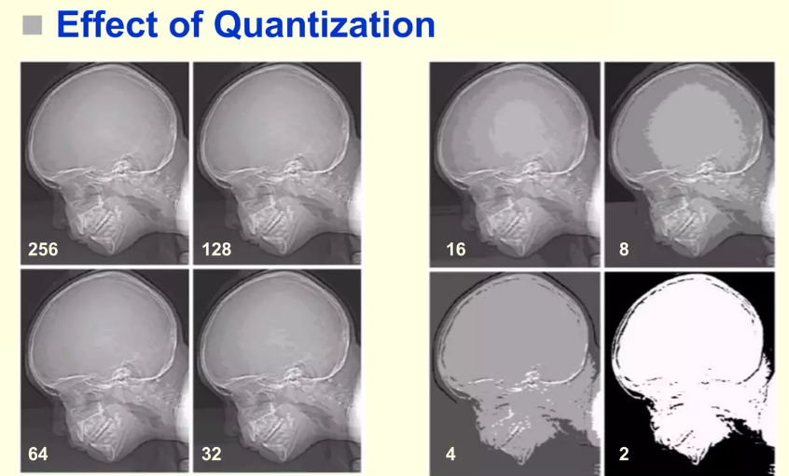
Understanding digital images

Slide 13
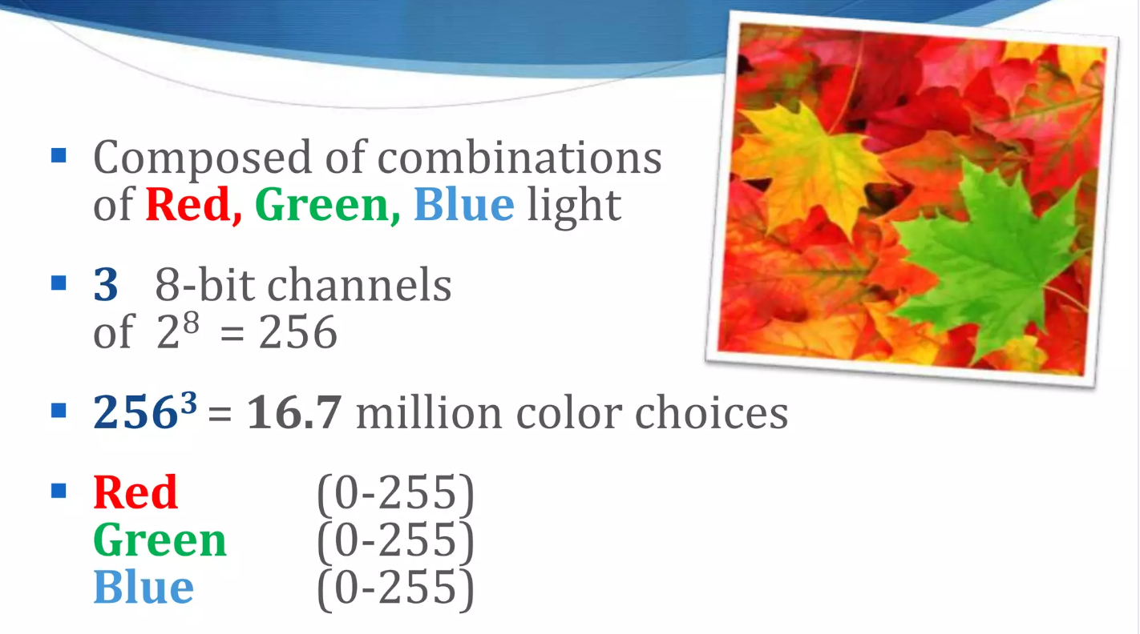
Understanding digital images
Pixel : 24 bit – Full Color – RGB

Slide 14
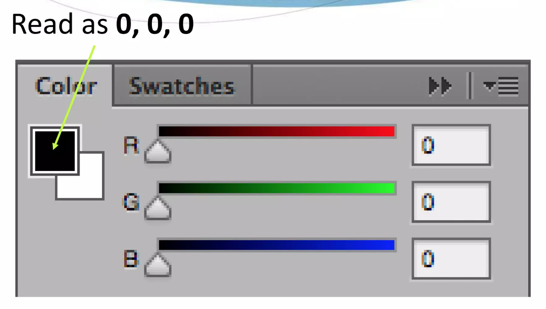
Understanding digital images
Pixel : 24 bit – RGB Color Slider

Slide 15
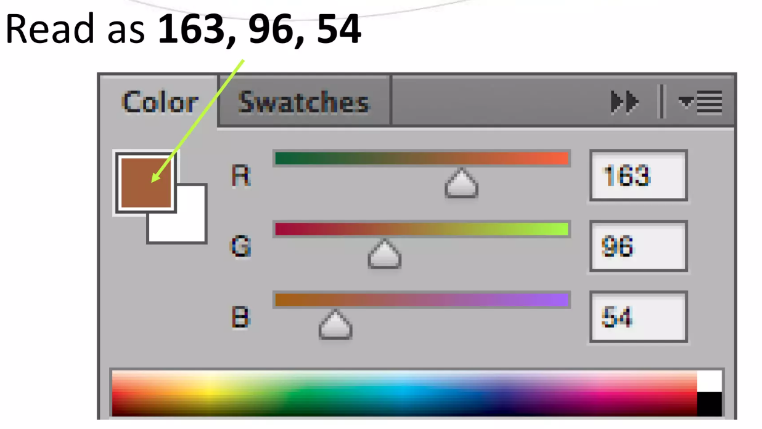
Understanding digital images
Pixel : 24 bit – RGB Color Slider

Slide 16
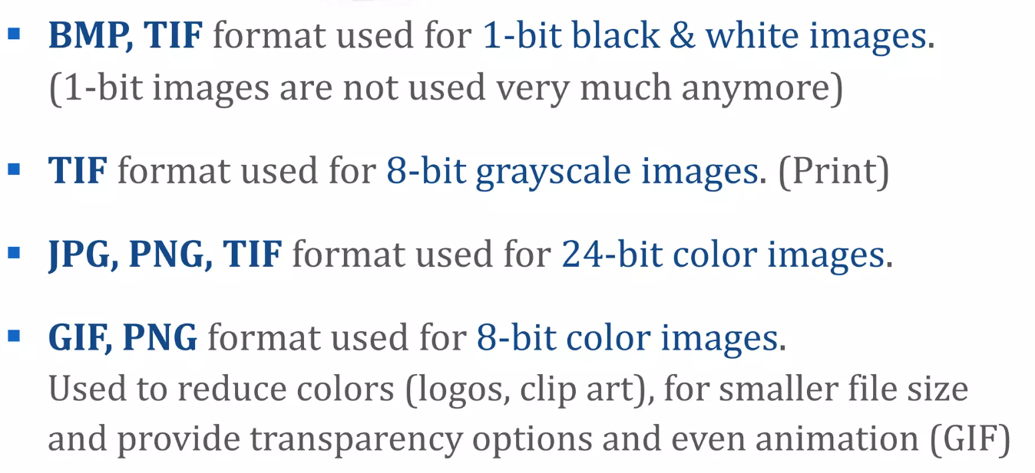
Understanding digital images
Image format

Slide 17
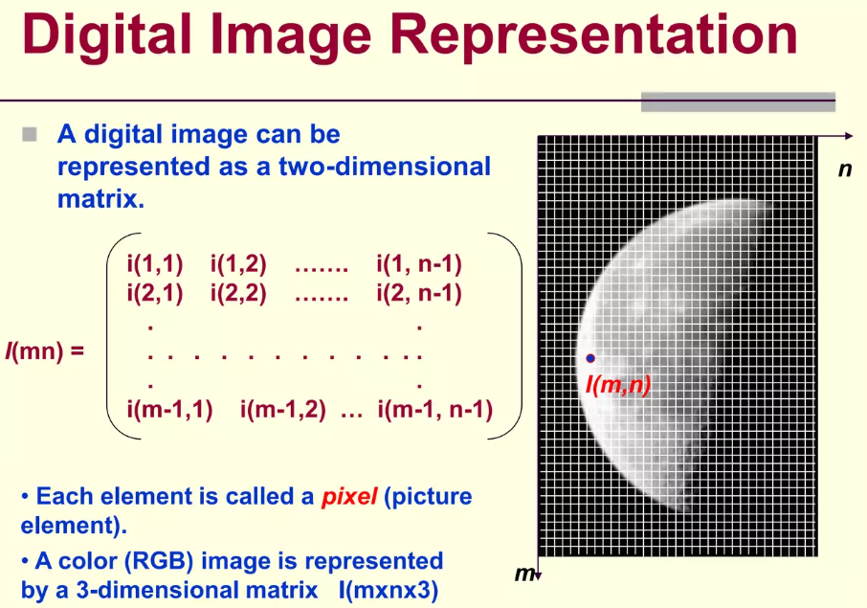
Understanding digital images

Slide 18
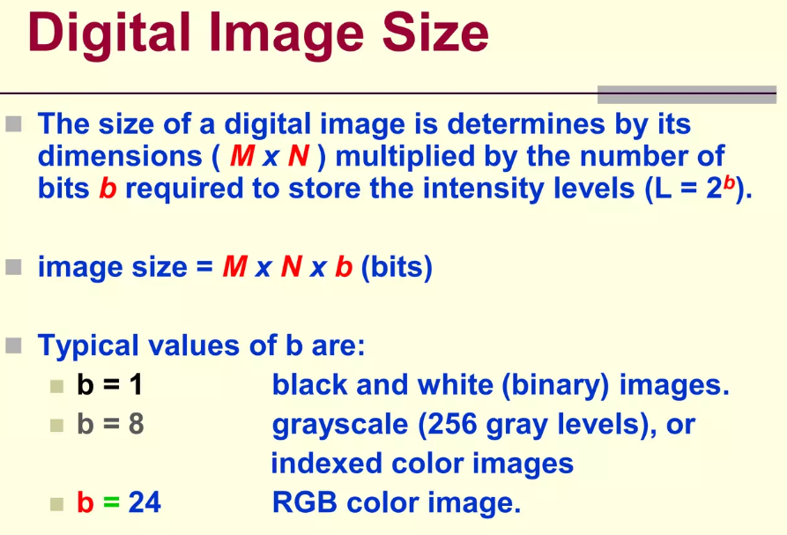
Understanding digital images

Slide 19
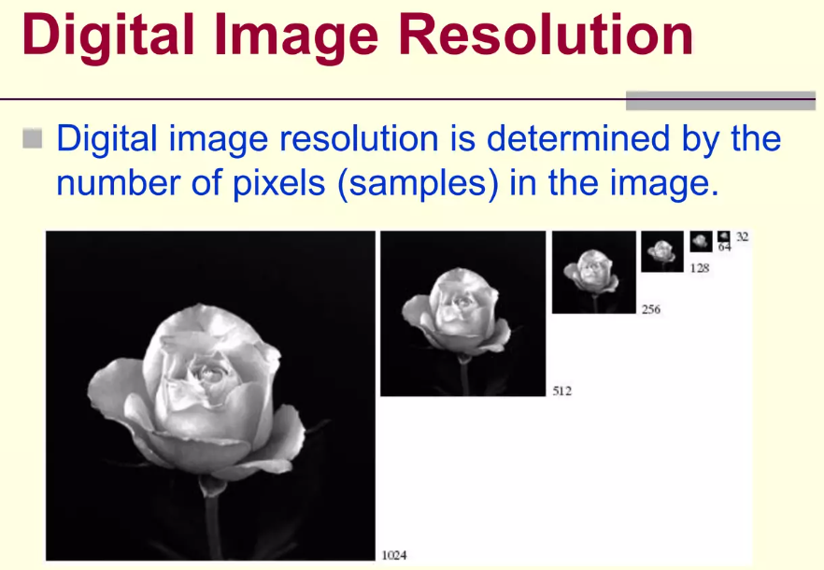
Understanding digital images

Slide 20
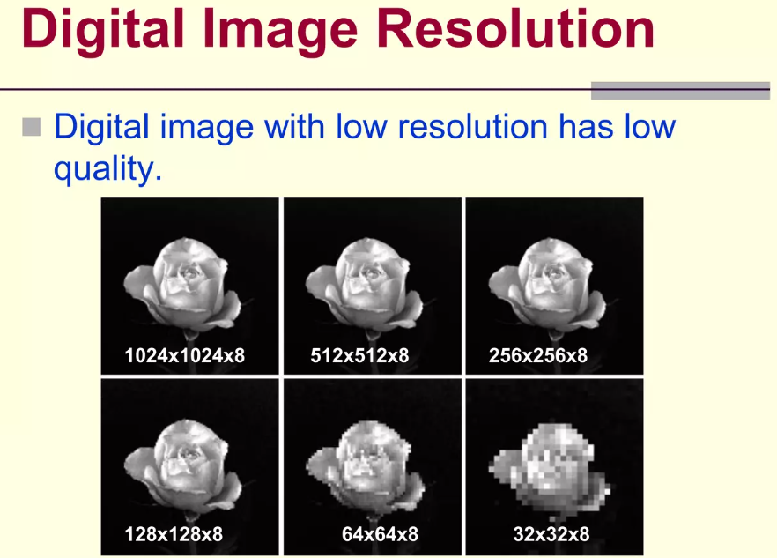
Understanding digital images

Slide 21
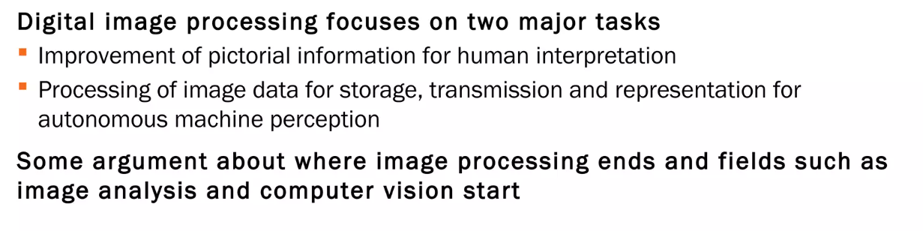
Understanding digital images
From Image Processing to Computer Vision

Slide 22
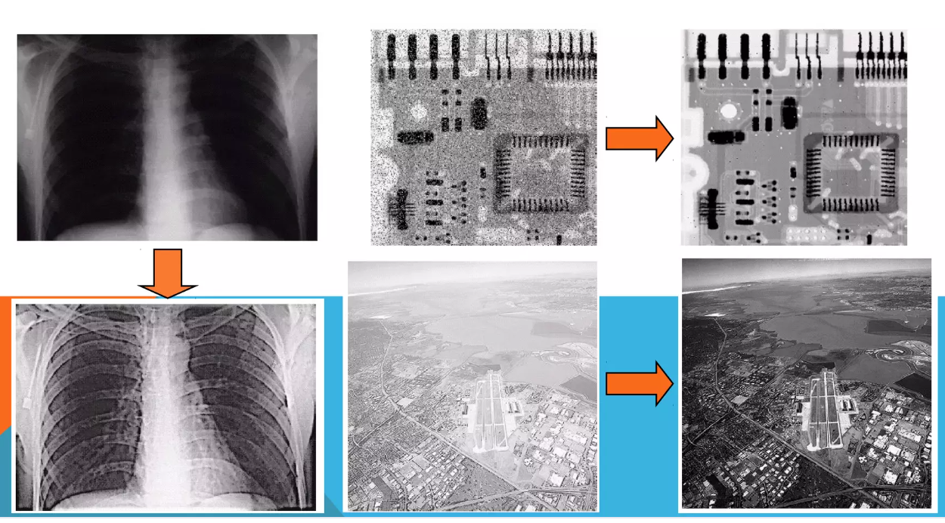
Understanding digital images
Image Processing

Slide 23
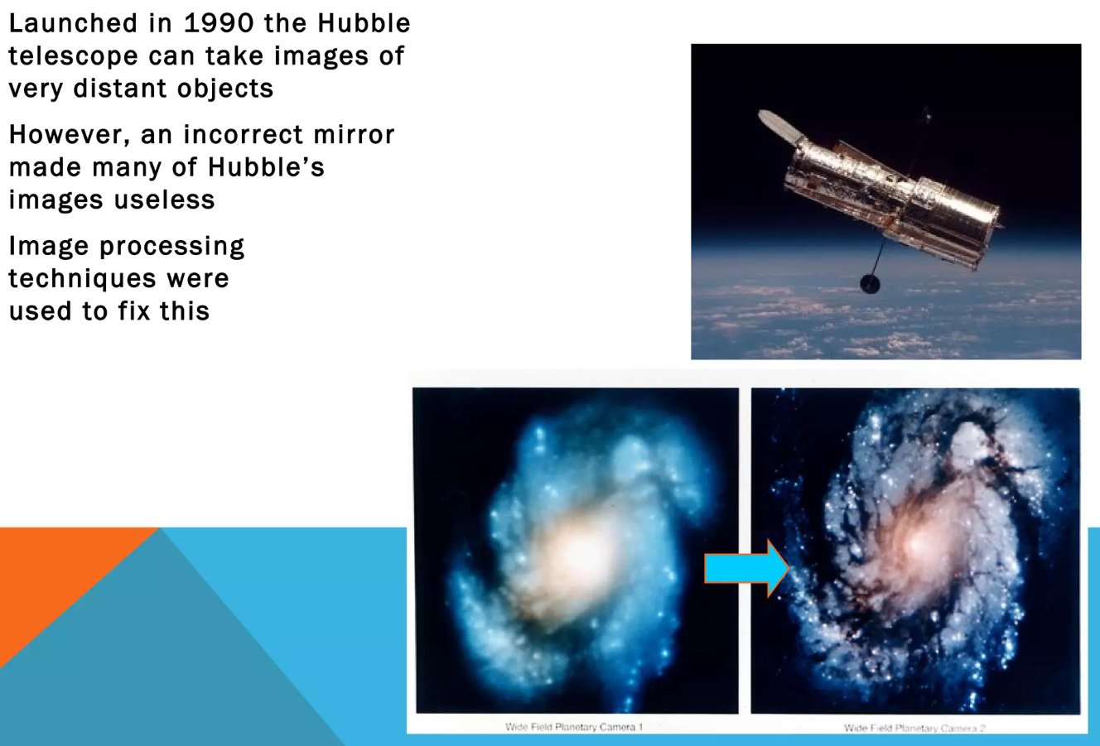
Understanding digital images
Image Processing : The HUBBLE TELESCOPE

